Slide 1
Work Experience Week
5-9 July 2027

Slide 2





Benefits
Notes:
Many people think that work experience is just an opportunity to learn about a job that interests you, but there are so many more important benefits:
-Building work ready skills is the core gain of taking part in work experience. It helps you to understand the importance of good communication, reliability, initiative to name a few.
-Finding a placement helps you learn how to contact and communicate with employers with confidence, which is such an important life skill.
-Being on placement pushes you outside your comfort zone and forces you to get along with strangers and try out many new things. This builds confidence and prepares you for your next steps
-Many work placements lead to part time work or offers of an apprenticeship
-Through persistence and perseverance young people who experience work are empowered to find more work experience to build confidence further.

Slide 3
Purpose
Develop work ready skills
Build confidence with employers
Learning outcomes
Building Skills: Practise teamwork, communication, problem-solving, and job search skills.
Growing Personally: Develop confidence, responsibility, and independence.
Finding Purpose: Understand how school learning connects to real jobs and goals.
Making Connections: Meet professionals who may support future opportunities.

Slide 4
Key details
You must find your own placement
It must be in the UK during the day
You must complete a self placement form with your parent providing the placement/ employer details before Friday 29th January! Act now!
School will make checks to ensure the placement is well safeguarded. These checks take time and must follow a very strict timeline, which is why the deadline is early.
If you miss the deadline and can’t find a placement you will be in normal lessons in school that week.

Slide 5
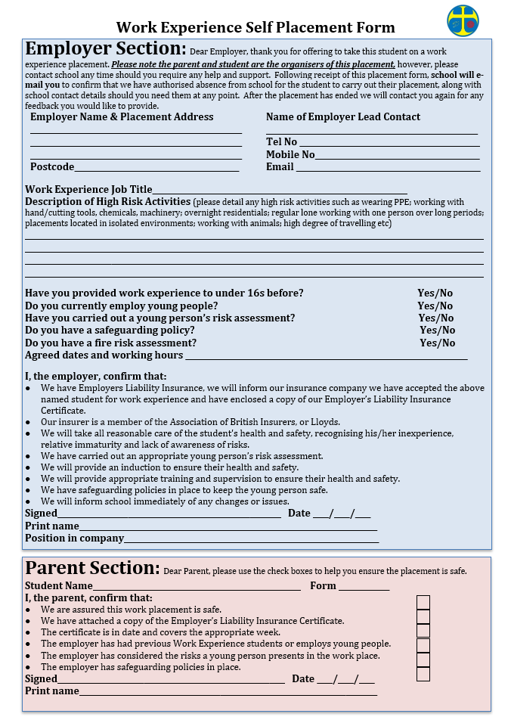
Notes:
This is the key form that must be completed by the deadline to ensure that school can make the necessary checks that the placement with well safeguarded.

Slide 6
First step
Go through the pack with your parents tonight!
Check that your parent agrees to you taking part and ask them to sign the Parental Agreement form and hand into the school office before this Friday 16th October.
Notes:
You only have 10 weeks to find a placement to act quickly

Slide 7
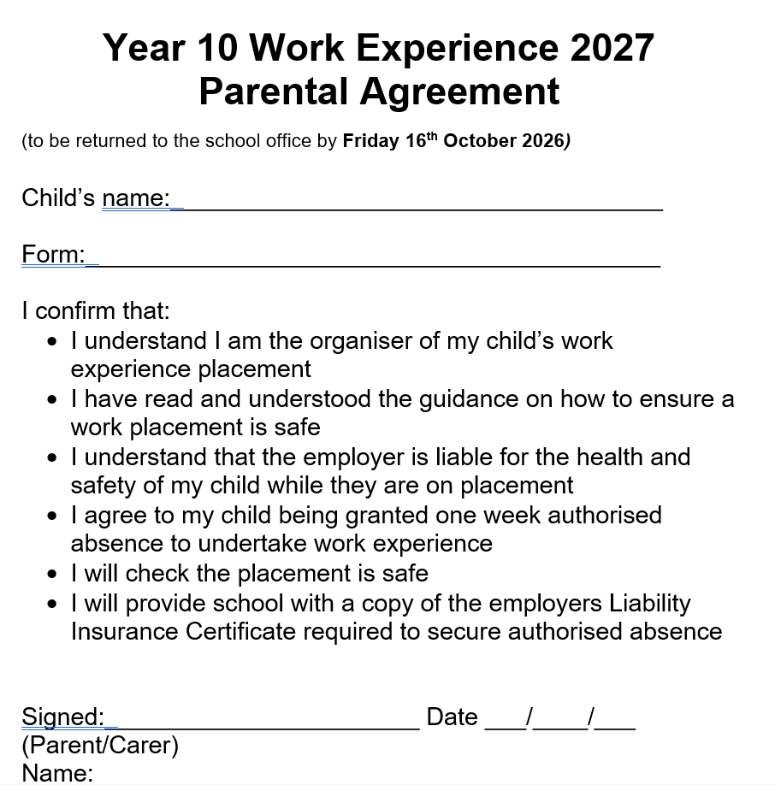

Slide 8


Why is it so hard to find a placement??
-no previous experience
-no references
-no basic work ready skills
-under 16s can be immature
-no confidence
high risk for employers

Slide 9

What’s the answer?
Rethink what your first work experience should be. You just need somewhere that will:
-help you develop confidence at your pace
-help you develop basic work ready skills
-make you feel helpful and useful
-give you a good reference
It doesn’t need to be related to a career
at this stage

Slide 10

What’s the answer?
-You need someone who can vouch for you!
-Explore placements with family and friends
-Employers who value very young people:
*Primary Schools/Nurseries/Kiddy Clubs
*Elderly Care Homes/Elderly support services
*Leisure Centres/Theme Parks/Ball Pool Centres
*Local Government/Libraries/councils/ Community projects
-Employers that employ young people for Saturday jobs:
*Cafes/Resturants
*Salons/Hairdressers
*Local Shops/Bakeries etc
Notes:
The easiest and best way to find a placement is to reach out to your network of family and friends and ask if they could vouch for you with their employer and to ask if that employer would consider you for a placement.

Slide 11

Notes:
Act now, don’t bury your head in the sand as there limited supportive employers in the area.

Slide 12

Notes:
Work experience isn’t just about you trying out a career you might be interested in,
It’s a chance to develop all the skills, qualities and understanding you need for your next steps
Embrace this opportunity, really capitalise on it!

Slide 13

Notes:
This is your experience, make it what you want it to be, it doesn’t have to be in a career you’re interested in. Target employers that you’d like to work for part time, it might be that you just want to see if you like office work, think about what you’d like to get out of this experience!!

Slide 14

Your network of family and friends
Notes:
Who do you know, who do you have a good reputation with and where do they work
Research the companies they work at, is there someone in that company that does a job you’re interested in.
Ask the family member of friend for help with approaching the employer
This family member of friend will most likely be able to help with travel during the week
70% of job vacancies in the UK are never advertised publicly, most people find jobs by knowing other people and having a good reputation with those people

Slide 15
Previous employers that have offered Work Experience
Placement | Job description
SPS (EU) Ltd | Accounts Administrator
Rochdale Police Station | Administration Assistant
Tidy Tax Ltd | Administration Assistant
Inspire Medical Centre | Administration Assistant
Halliday Healthcare Ltd | Administrative Assistant
Castelton Health Centre | Administrator for Health Care
Donkey Sanctuary Manchester | Animal Care Assistant
Calrec Audio | Audio Assistant
Slattery | Baker Assistant
Burnley Council | Community Engagement Assistant
Runamok Play and Party Centre | Crew Member
Marks and Spencer Plc | Customer Assistant
Boots | Customer Assistant
Rawtenstall Library | Customer Assistant
Boohoo | Customer Service Advisor
Oldshire Farm Foods Ltd:T/A Wiltshire Farm Foods | Customer Service Assistant
Ski Rossendale | Customer Service Assistant
Tesco | Customer Service Assistant
Rossendale Dance and Drama Centre | Dance Teacher
Pendleside Hospice | Day Services Assistant
Drake Dental Practice | Dental Assistant
Inglewood House Dental Practice | Dental Assistant
Denpoint | Dental Assistant
East Lancashire Box Co LTD | Design Assistant
AECOM | Design Assistant
Arena Creative Design | Design Assistant
Staghills Nursery School | Early Years Assistant
Jaguar/Landrover | Engineering Assistant
Notes:
If you are really struggling to find anything, Miss Grenaghan has a list of companies other students in the Rossendale Area have used in the past, so just ask for the list!

Slide 16
Contacting the employer
Enquire about work experience using professional communication that includes a summary of your skills and qualities.
Say that you’re available for a telephone or face to face interview at any time.
Follow up e-mails or other written requests with a phone call. BE BRAVE!
Don’t overly rely on other people, this is your challenge, don’t wait weeks and weeks to hear back, BE PROACTIVE!
Consistently enquire until someone says yes.

Slide 17
3 Top Tips
1.Be persistent
– Don’t stop contacting and calling companies until someone gives you a very definite YES!
Notes:
People in companies are really busy so you’ll have to do the running around, the e-mailing, the calling, just to get things moving. Be persistent and it will happen and you’ll find something
Get used to rejection, try not to take this personally, many companies are just too busy to provide a really good experience that they’d rather say no
Make sure you sound really interested, make sure you research the company beforehand to help you think of some questions
Prepare what you want to ask once they have said yes, such as when can I come in and meet you and get my form filled in, what should I wear, who should I ask for on my first day, is there any thing I can read in advance to help me be helpful to you etc.
All this guidance is in the guide you’ve been given, so use it if you’re really struggling

Slide 18

3 Top Tips
2. Avoid being too reliant on parents
– If your parents don’t know the company, you stand a better chance if you call or visit!
Notes:
Be aware that if you let parents make calls for you most companies will say no!
This is because their first impression is that you are not genuinely interested, lack communication skills, lack proactivity, the list goes on!

Slide 19
3 Top Tips
3. Deadlines
Keep to deadlines:
Friday 16 October for Parental Agreement form
Friday 29 January for Self Placement form

Slide 20
What now?
Read all the information in your pack with parents.
Get your parents permission to take part by completing the parental consent form deadline 3 OCT
Start looking for a placement NOW!
Ask for help if you’re struggling to find a placement or don’t know where to start.
Notes:
You’re competing against each other and any other school that has chosen this week for work experience, the earlier the ask, the easier and quicker it will be to get a placement.

Slide 21


